Slide 1
Electrical Circuits
EEE-281 Lecture Notes
Dr. Özçel Cangül
Lecture Notes by Dr. Ali Muhtaroğlu
Fall 2023
METU Northern Cyprus Campus
References:
Electric Circuits 10th Ed. by Nilsson & Riedel
Electrical Circuit Analysis 3rd Ed. by Johnson, Johnson, Hilburn, and Scott
Engineering Circuit Analysis 7th Ed. by Hayt, Kemmerly, and Durbin
Fundamentals of Electric Circuits 3rd Ed. by Alexander, and Sadiku

Slide 2
Circuit Elements,
Ohm’s and Kirchhoff’s Laws
Weeks 2-3
Reading: Nilsson & Riedel Chapter 2
Ali Muhtaroğlu

Slide 3
Lumped-Parameter Circuit Model
An electrical circuit is fully characterized by:
Elements it contains
How the elements are interconnected
+
-
Ali Muhtaroğlu

Slide 4
Lumped-Parameter Circuit Model
An electrical circuit is fully characterized by:
Elements it contains
How the elements are interconnected
Wires are perfect conductors;
cannot accummulate charge,
cannot dissipate energy
+
-
Ali Muhtaroğlu

Slide 5
Lumped-Parameter Circuit Model
An electrical circuit is fully characterized by:
Elements it contains
How the elements are interconnected
Wires are perfect conductors;
cannot accummulate charge,
cannot dissipate energy
Energy lumped within elements
+
-
Ali Muhtaroğlu

Slide 6
Lumped-Parameter Circuit Model
An electrical circuit is fully characterized by:
Elements it contains
How the elements are interconnected
Wires are perfect conductors;
cannot accummulate charge,
cannot dissipate energy
Energy lumped within elements
+
-
Node: A point where two or more circuit elements meet
Ali Muhtaroğlu

Slide 7
Ideal Independent Sources
The terminal voltage of an ideal voltage source is constant, regardless of the current flowing in those terminals. The voltage source is independent if it establishes a voltage across its terminals without relying on voltages or currents elsewhere in the circuit.
The current of an ideal current source is constant, regardless of the voltage across its terminals. The current source is independent if it establishes a current without relying on voltages or currents elsewhere in the circuit.
OR
Ali Muhtaroğlu

Slide 8

Dependent Sources
The terminal voltage of a dependent (controlled) voltage source depends on a voltage or a current defined at some other location in the circuit. Two types are:
VCVS : Voltage-controlled voltage source
CCVS : Current-controlled voltage source
The current of a dependent (controlled) current source depends on a voltage or a current defined at some other location in the circuit. Two types are:
VCCS : Voltage-controlled current source
CCCS : Current-controlled current source
Ali Muhtaroğlu

Slide 9
Dependent Sources (Linear Controlled)
VCVS: CCVS:
VCCS: CCCS:
μ : voltage gain (dimensionless)
r : transresistance (ohms)
g : transconductance (siemens)
β : current gain (dimensionless)
Ali Muhtaroğlu

Slide 10
Series Voltage Sources
A chain of series voltage sources is equivalent to a single voltage source whose source function is the algebraic sum of the series source functions.
≡
Ali Muhtaroğlu

Slide 11
Series Voltage Sources
A chain of series voltage sources is equivalent to a single voltage source whose source function is the algebraic sum of the series source functions.
≡
Series Current Sources
The series current source functions have to be all equal in a chain of series current sources, in which case the chain is equivalent to any one of them. Otherwise there is a mathematical inconsistency.
≡
Ali Muhtaroğlu

Slide 12
Parallel Current Sources
A set of parallel current sources is equivalent to a single current source whose source function is the sum of the parallel source functions.
≡
Ali Muhtaroğlu

Slide 13
Parallel Current Sources
A set of parallel current sources is equivalent to a single current source whose source function is the sum of the parallel source functions.
≡
Parallel Voltage Sources
A set of voltage sources in parallel must have equal source functions in which case any one of them is equivalent to the entire set. Otherwise there is a mathematical inconsistency.
≡
Ali Muhtaroğlu

Slide 14
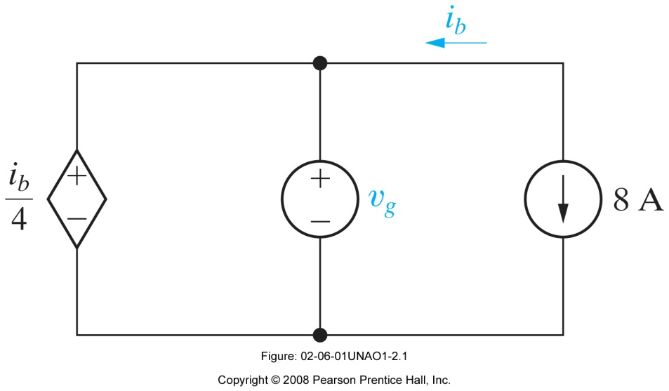
Example
For the circuit shown, a) what value of v_{g} is required in order for the interconnection to be valid? b) For this value of v_{g}, find the power associated with the 8 A source.
Ali Muhtaroğlu

Slide 15
Example
For the circuit shown, a) what value of v_{g} is required in order for the interconnection to be valid? b) For this value of v_{g}, find the power associated with the 8 A source.
i_{b} = -8 A and v_{g} = i_{b} /4 = -2 V
b) P = V . I = -2 V . 8 A = -16 W (16 W delivered or generated)
Solution
Ali Muhtaroğlu

Slide 16
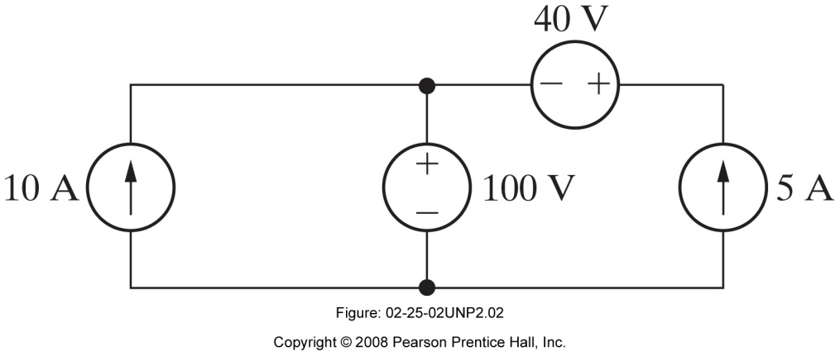
Example 2
If the interconnection in the below figure is valid, find the power developed by the current sources. If the interconnection is not valid, explain why.
Ali Muhtaroğlu

Slide 17
Example 2
If the interconnection in the below figure is valid, find the power developed by the current sources. If the interconnection in not valid, explain why.
There are no inconsistencies (different voltage sources connected in parallel, or different current sources connected in series).
The total power of the current sources is:
10A.100V + 5A.140V=1700 W
Solution
Ali Muhtaroğlu

Slide 18
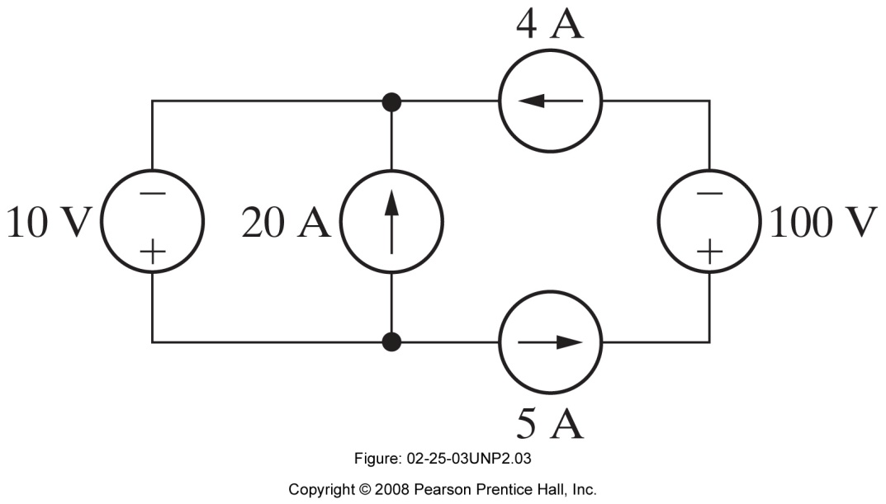
Example 3
If the interconnection in the below figure is valid, find the total power developed by the voltage sources. If the interconnec-tion is not valid, explain why.
Ali Muhtaroğlu

Slide 19
Example 3
If the interconnection in the below figure is valid, find the total power developed by the voltage sources. If the interconnec-tion in not valid, explain why.
The 4 A and 5 A current sources connected in series create an inconsistency. This interconnection is not valid.
Solution
Ali Muhtaroğlu

Slide 20
Resistance and Resistivity
A
For a given conductor with length l, and cross-sectional area A:
where ρ is the material resistivity.
l
Ali Muhtaroğlu

Slide 21
Ohm’s Law
The voltage across a resistor is directly proportional to the current flowing through the resistor.
Power consumed by a resistor:
R : Resistance in Ohm (Ω)
R ≥ 0
Ali Muhtaroğlu

Slide 22
Conductance (G)
Unit: Siemens (S) or Mho ( )
Ω
Ali Muhtaroğlu

Slide 23
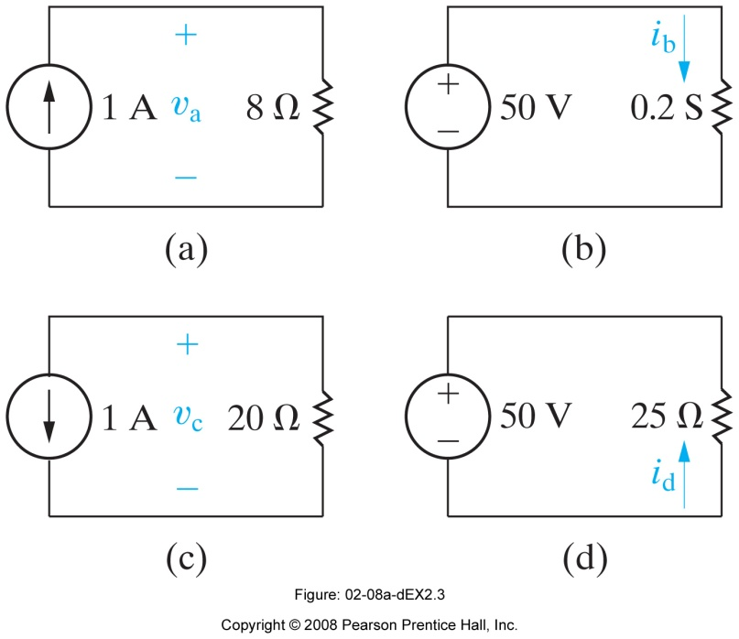
Example
i) Calculate the value of v and i in the following circuits. ii) Determine the power dissipated in each resistor.
Ali Muhtaroğlu

Slide 24
Example
i) Calculate the value of v and i in the following circuits. ii) Determine the power dissipated in each resistor.
Solution
i) v_{a} = (1)(8)=8 V ; i_{b} = (50)(0.2)=10 A ; v_{c} = -(1)(20)=-20 V ; i_{d} = -50/25= -2 A
ii)
Ali Muhtaroğlu

Slide 25
Short Circuit
A short circuit is a perfect conductor or conductor with zero resistance. Two nodes can be short circuited by connecting them with a wire. A short circuit can sustain current without any voltage drop. [In reality, there always is a max. current limit after which damage occurs to the material.]
An open circuit is a perfect insulator or resistor with zero conductance. An open circuit can sustain any voltage without any flow of current. [Again there is always a max. practical limit after which breakdown occurs.]
(Circuit modeling: Read Nilsson Examples 2.4, 2.5)
Open Circuit
Ali Muhtaroğlu

Slide 26
Kirchhoff’s Current Law (KCL)
The sum of the currents entering any node equals the sum of the currents leaving the node.
(The algebraic sum of all the currents at any node in a circuit equals zero.)
i₂
i₃
i₁
i₄
i₅
+
-
Ali Muhtaroğlu

Slide 27
Kirchhoff’s Current Law (KCL)
The sum of the currents entering any node equals the sum of the currents leaving the node.
(The algebraic sum of all the currents at any node in a circuit equals zero.)
Our convention:
+ for currents exiting the node
- for currents entering the node
i₂
i₃
i₁
i₂ + (– i₁) = 0
i₄
i₅
i₃ + i₄ + (– i₂) = 0
+
-
i₅ + (– i₃) = 0
Ali Muhtaroğlu

Slide 28
Kirchhoff’s Voltage Law (KVL)
The sum of voltage drops around any closed path is zero.
+
v₂
-
+
+
+
+
v₁
-
v₃
v₄
-
-
-
Ali Muhtaroğlu

Slide 29
Kirchhoff’s Voltage Law (KVL)
The sum of voltage drops around any closed path is zero.
Our convention:
+ if traversing + to – terminal clockwise
- if traversing – to + terminal clockwise
+
v₂
-
(-v₁) + v₂ + v₃ = 0
+
+
+
+
v₁
-
v₃
v₄
-
-
-
Ali Muhtaroğlu

Slide 30
Kirchhoff’s Voltage Law (KVL)
The sum of voltage drops around any closed path is zero.
Our convention:
+ if traversing + to – terminal clockwise
- if traversing – to + terminal clockwise
+
v₂
-
(-v₁) + v₂ + v₃ = 0
+
+
+
(-v₃) + v₄ = 0
+
v₁
-
v₃
v₄
-
-
-
Ali Muhtaroğlu

Slide 31
Example
An electric circuit was built as below. Use KCL and KVL to solve for unknown current and voltages:
+
1 V
-
i₁
+
v₂
-
2A
i₂
+
-
+
4 V
-
v₁
v₃
+
-
1 V
i₃
-
+
+
v₄
i₄
-
Ali Muhtaroğlu

Slide 32
Example
An electric circuit was built as below. Use KCL and KVL to solve for unknown current and voltages:
Due to lumped-parameter assumptions, wires are perfect conductors. Therefore, v₂= v₄ = 0. v₃ =- v₁ . i₁= i₃=0, because there is no closed circuit loop for current to flow. i₂= i₄=2 A using KCL, and v₁ =-2V using KVL.
+
1 V
-
i₁
+
v₂
-
2A
i₂
+
-
+
4 V
-
v₁
v₃
+
-
1 V
i₃
-
+
+
v₄
i₄
-
Ali Muhtaroğlu

Slide 33
Example 2
Use KCL and KVL to solve for unknown current and voltages:
6 A
-
9 V
+
2 A
+
5 V
-
i₅
i₃
1 A
i₄
+
-
+
v₂
v₁
3 V
-
+
-
-
11 V
i₆
-
2 V
+
+
-3 A
10 A
i₈
i₇
Hint: 8 unknowns require 8 independent equations to solve
Ali Muhtaroğlu

Slide 34
Example 2 (continued)
8 unknowns : Require 8 independent equations to solve
KVL:
KCL:
Solving all:
Ali Muhtaroğlu

Slide 35
Example 3 (Ex 2.10)
Use Kirchhoff’s laws and Ohm’s law to find the voltage v₀ as shown below.
Show that your solution is consistent with the constraint that the total power developed in the circuit equals the total power dissipated.
Ali Muhtaroğlu

Slide 36
Example 3 (Ex 2.10)
Use Kirchhoff’s laws and Ohm’s law to find the voltage v₀ as shown below.
Show that your solution is consistent with the constraint that the total power developed in the circuit equals the total power dissipated.
Solution:
Ali Muhtaroğlu

Slide 37
Example 4 (AP 2.10)
The current i_{Φ} in the circuit shown is 2 A. Calculate:
a) v_{s} ; b) The power absorbed by the independent voltage source,
c) The power delivered by the independent current source,
d) The power delivered by the controlled current source,
e) The total power dissipated in the two resistors.
Ali Muhtaroğlu

Slide 38
Example 4 (AP 2.10)
The current i_{Φ} in the circuit shown is 2 A. Calculate:
a) v_{s} ; b) The power absorbed by the independent voltage source,
c) The power delivered by the independent current source,
d) The power delivered by the controlled current source,
e) The total power dissipated in the two resistors.
Solution:
i₁
Ali Muhtaroğlu

Slide 39
Example 4 (AP 2.10)
The current i_{Φ} in the circuit shown is 2 A. Calculate:
a) v_{s} ; b) The power absorbed by the independent voltage source,
c) The power delivered by the independent current source,
d) The power delivered by the controlled current source,
e) The total power dissipated in the two resistors.
Solution (continued):
-
v_{ϕ}
+
i₁
i_{s}
+
v₁
-
Ali Muhtaroğlu

